Slide 1
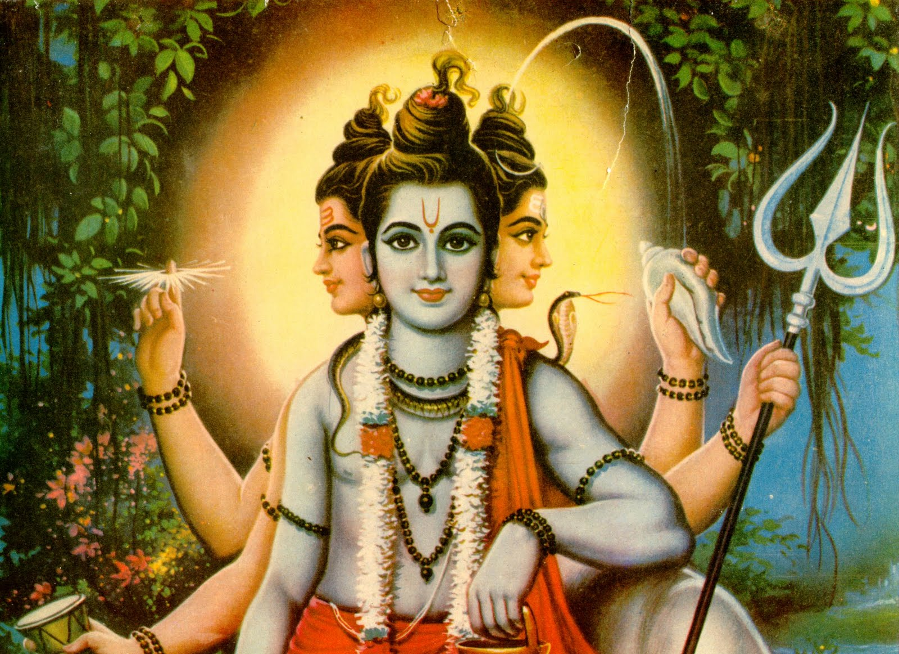
HINDUISM
BY: MATTHEW MCMAHON

Slide 2
When did it start?
Hinduism started about 4,000 years ago. A culture referred to as the “Aryans” have all of their history in one book called the Vedas. In the book are sacred songs very holy to the culture.

Slide 3
Where did it start?
Hinduism started in India and now is one of the largest religious cultures in the world.

Slide 4
Who was the founder?
The founder of Hinduism was .. Nobody knows! It could have been the Jews or the Christians, but it’s not for sure. Some say it may be “Satans”.

Slide 5
What are the beliefs?
They believe in karma, an endless cycle of world creation, all life is sacred, divinity of the 4 Vedas, and in a one.

Slide 6
How do they worship?
In public, they pray at temples, in private a person may pray on a home shrine, statue, or symbol.

Slide 7
Do they have a god(s)?
They do have a god. His name is “Brahman”. He created everything you can think about for the Hindus. They said he was personal.

Slide 8
Afterlife?
Yes, Hindus believe in afterlife. They call it rebirth. They believe that people live and die over and over again.

Slide 9
Anything Else?
Hinduism is said to be the oldest religion still running in the world.

